Slide 1



Modeling SABSA® in ArchiMate®
01
Practicing of Archi (ArchiMate Modeling Tool)
Repository: github.com/yasenstar/ArchiMate_SABSA

Slide 2








About Me – An Enterprise Architecture Practitioner
Journey with The Open Group
TOGAF 9 Certified: 2013
ArchiMate 3 Practitioner: 2021
Professional Level 2 Architect: 2021
ArchiMate Essential 3.2: 2025
Other Architecture Learning
Certified Business Architect: 2021
Journey with ISACA
CobiT Certified: 2006
CISA – Info Sys Auditor: 2007
CISM – Info Sec Mgr: 2007
CGEIT GrandFather Certified: 2008
CRISC – Risk & InfoSys Control: 2017
CDPSE – Data Privacy Solution: 2020
Other Security and Service Mgmt
ITIL Manager Certified: 2002
PMP: 2003
CISSP: 2016
Security Journey – White/Yellow/Green Belt: 2024
Repository: github.com/yasenstar/ArchiMate_SABSA
Notes:
COBIT: Control Objectives for Information and Related Technology

Slide 3
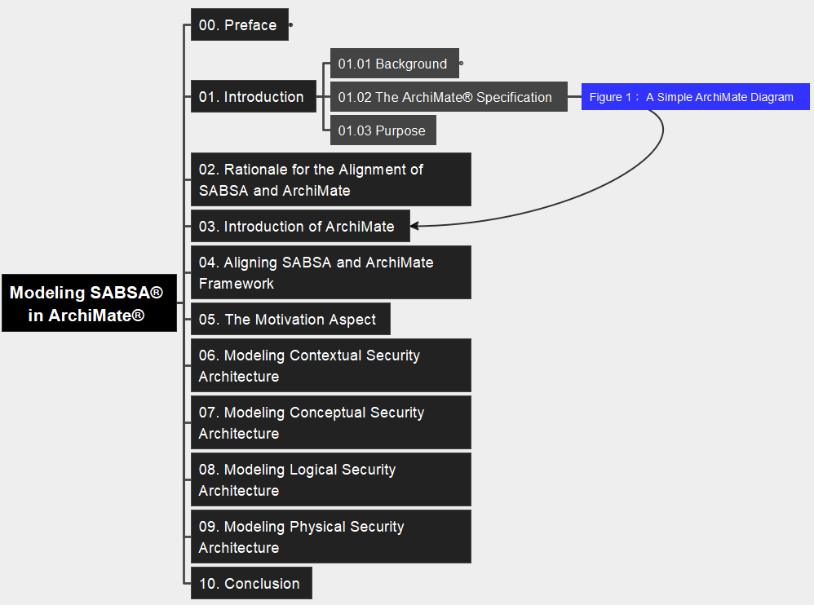
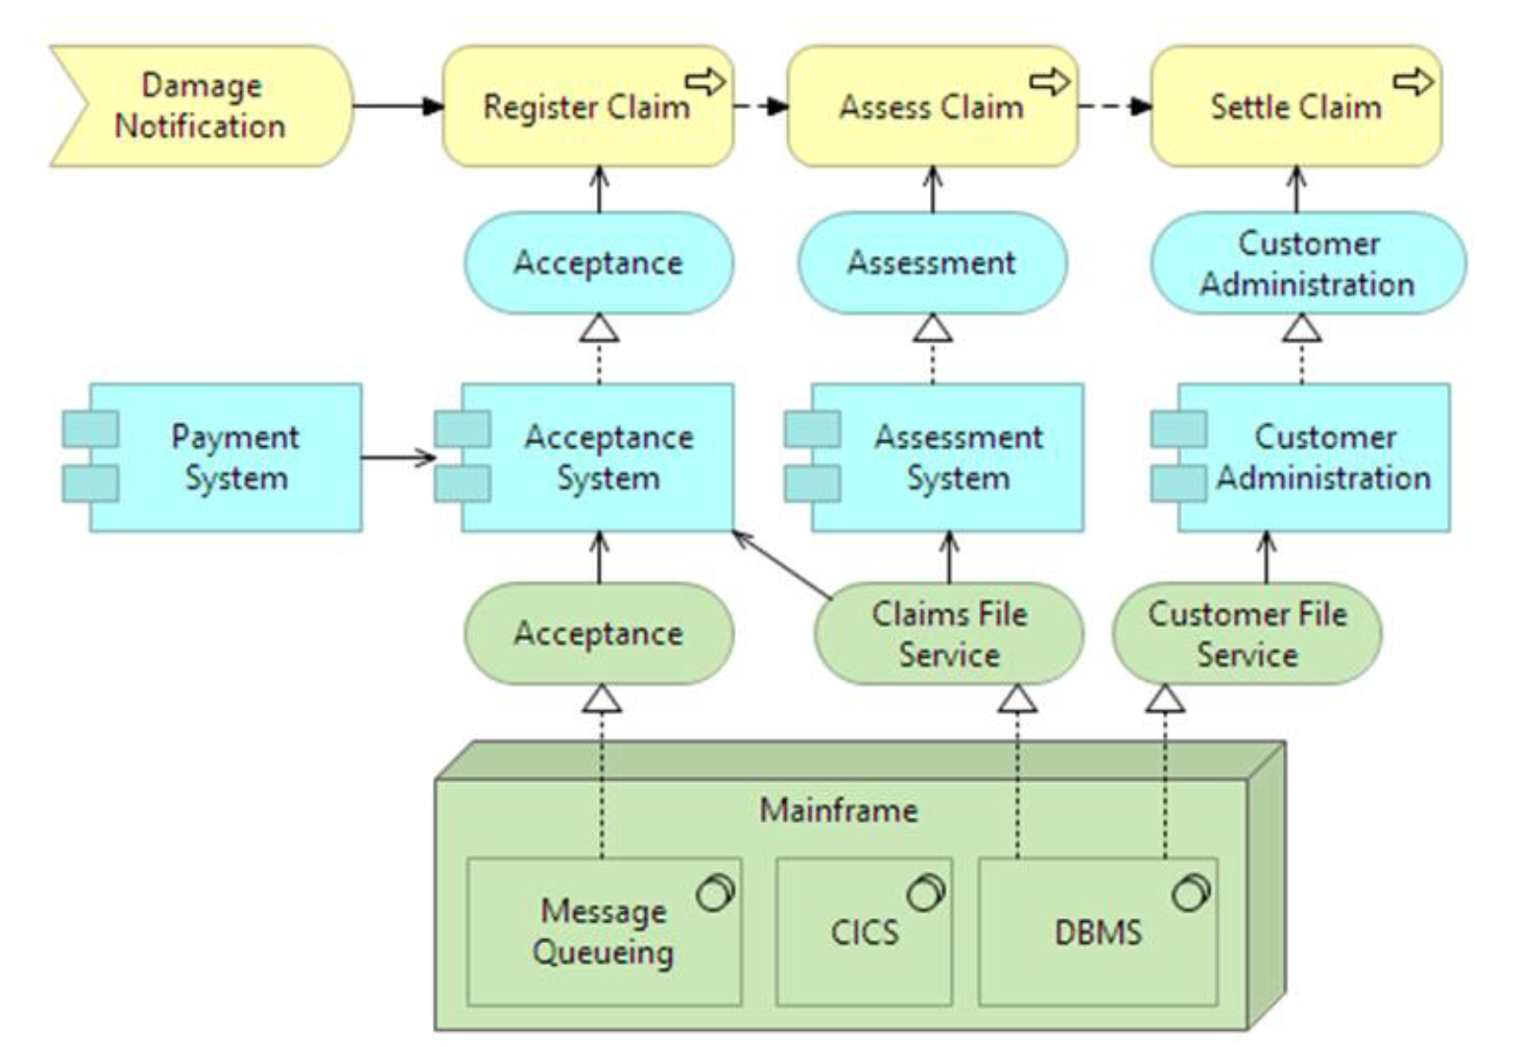
01 Introduction Figure 1: A Simple ArchiMate Diagram
02

Slide 4
01 Introduction F
03

Slide 5



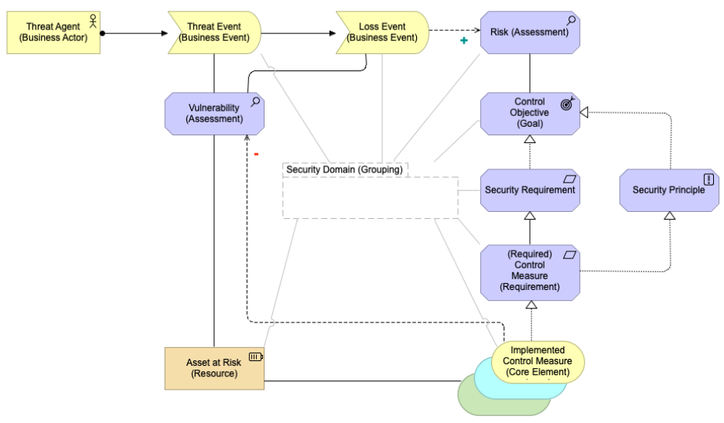
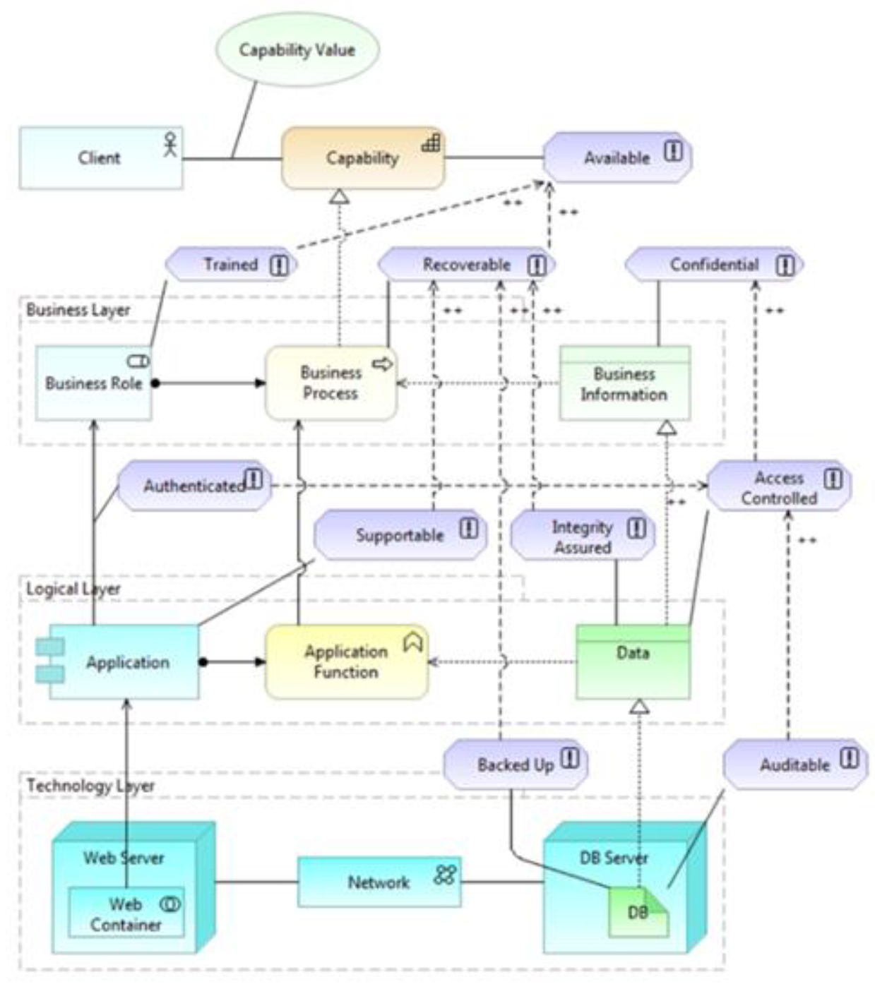
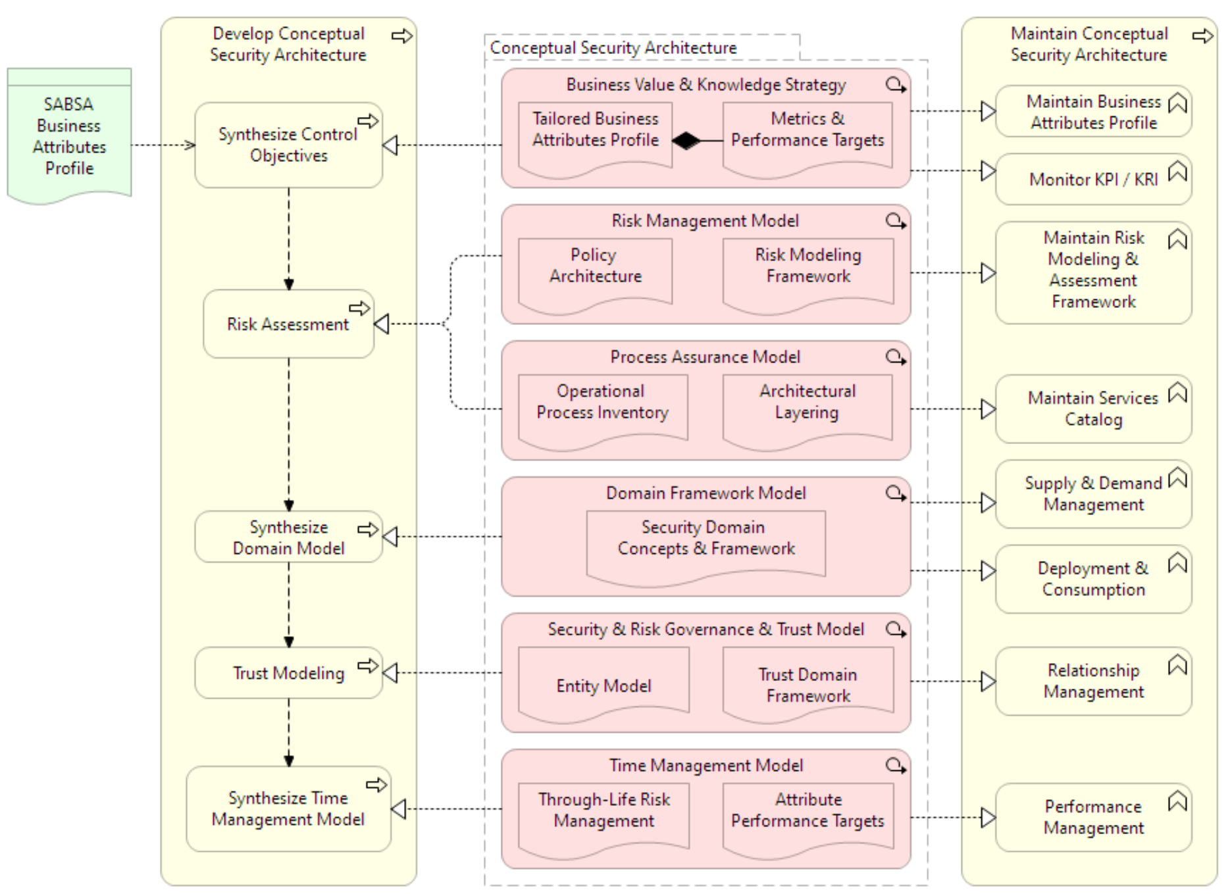
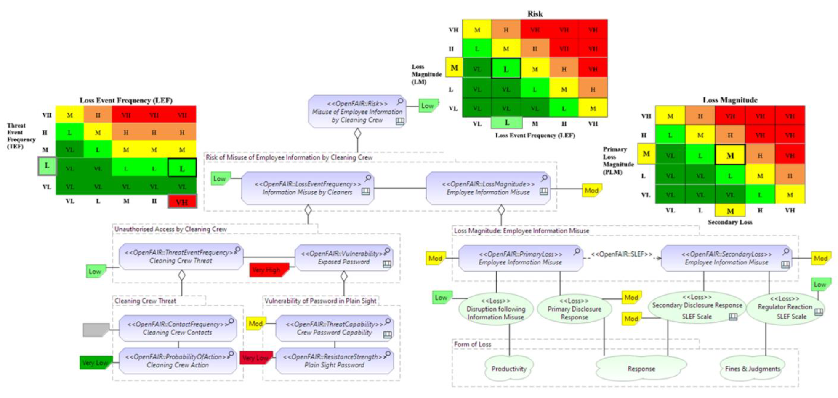

Slide 6




ArchiMate
UML
BPMN

